Slide 1
Agentic AI Strategy
NAB and Accenture considerations
September 9, 2025
Dermot O’Brien
PRELIMINARY
AI Assisted
CURATED

Slide 2
Agentic Platform - Strategic Position
DRAFT
Strategic Question | Door Type | Rationale for Door Type | Urgency | Answer
1. NAB Strategy Alignment. How should we align with the NAB agentic platform strategy? | One-Way | Parent company strategic alignment decisions create long-term constraints on technology choices, vendor relationships, and operational models. | High | NAB have a preference for build / open-source on the spectrum of buy versus build. Recognising our scaling constraints vs our ambition, we have a preference for “buy + build” i.e. buy maturity acceleration via key partnerships (Accenture + AI Refinery) while also maintaining a “build” position in alignment with NAB agentic framework and platform choices (e.g. LangGraph etc / AgentCore etc).
Accenture Questions
2. Target Users. Who will be the target user for the agentic platform i.e. core developer or high code (HC), no code (NC) or low code (LC)? | Two-Way | User democratization strategies can be adjusted iteratively; business vs. technical user balance evolves with organizational maturity. | Medium | Progressive democratization strategy starting with technical teams (developers, data scientists) and expanding to business users through curated low-code interfaces. Begin with developer-focused tools, add visual builders later.
3. ISV Agent Reusability. How much flexibility is desired for the reuse of ISV developed agents? | One-Way | Platform architecture decisions fundamentally determine future flexibility; difficult to change vendor ecosystem approach once established. | High | High flexibility with governance guardrails. Choose platforms supporting open standards (MCP, LangGraph, A2A) with vendor-agnostic agent deployment capabilities. Prioritize interoperability over vendor lock-in.
4. Operations Strategy. What is the long-term strategy for platform (agent development, deployment) i.e. self managed or fully managed by consultancy partners? | Two-Way | Can transition from vendor-managed to self-managed over time; operational models can evolve based on experience and scale. | Medium | Hybrid approach with progressive internalization. Start with vendor-managed implementation (Accenture AI Refinery) and transition to self-managed operations as internal capabilities mature over 18-24 months.
5. Platform Modularity. What is the ideal desired platform modularity within infrastructure, models, knowledge layer, agent and observability / governance? | One-Way | Core architectural decisions about modularity are difficult to reverse; monolithic vs. modular and agentic vs microservices choices have long-term lock-in implications. | High | Microservices architecture with clear separation between infrastructure, models, knowledge layer, agents, and governance. Enable independent scaling and vendor flexibility at each layer. Knowledge layer must align / complement our digital, data & analytics ambition. Infrastructure and observability must align with our existing standards.
6. Update Cadence. How often will we consider component choices within the platform and what is the process to update modules / services within the platform? | Two-Way | Governance processes and update frequencies can be refined based on operational experience and regulatory feedback. | Low | Quarterly technology reviews with monthly operational updates. Implement continuous deployment for non-critical updates, quarterly reviews for architectural changes, annual strategic technology assessments.
7. Decision Timing. Which platform / module / service decisions are we be comfortable making now vs later? | One-Way | Foundation infrastructure and vendor choices create path dependencies; delayed decisions compound complexity and limit future options. | High | Immediate decisions: Core platform architecture, primary vendor partnerships, security frameworks, agentic frameworks. Deferred decisions: Specific agent implementations, advanced features, secondary integrations. Focus on foundational choices first.

Slide 3
NAB agentic strategy alignment
NAB have a preference for build / open-source on the spectrum of buy versus build. Recognising our scaling constraints vs our ambition, we have a preference for “buy + build” i.e. buy maturity acceleration via key partnerships (Accenture + AI Refinery) while also maintaining a “build” position in alignment with NAB agentic framework and platform choices (e.g. LangGraph etc / AgentCore etc).

Slide 4


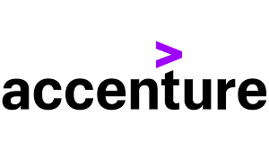
Considering alignment with NAB Agentic AI strategy
Purpose
Assess the alignment of Accenture AI Refinery against NAB Agentic AI Strategy [1] ¹. Use the assessment to fast start our BNZ Target State Architecture for Agentic AI.
NAB Agentic AI Strategy
Favour build over buy
Favour open over vendor proprietary
Summary
This is an early / preliminary assessment pending further clarifications (which may change the assessment). The BNZ Agentic AI Strategy and Target State Architecture (TSA) have not yet been elaborated. We will use our Accenture / BNZ AI Refinery design [2][3] and the NAB Agentic AI lexicon to fast track our target state definition. For the purposes of this assessment, we assume that AI Refinery will be aligned by default to the (eventual) BNZ Agentic AI TSA i.e. the target state for Agentic AI will be reverse engineered from the AI Refinery for BNZ design and refined to address limitations with AI Refinery and to leverage NAB work.
AI Refinery provides us with a fast start into agentic AI by leveraging Accenture experience and expertise.
However, AI Refinery (as a SaaS offering) is misaligned with NAB Agentic AI strategy and has not been considered by NAB.
Even without considering NAB alignment, AI Refinery has limitations, including being limited to NVIDIA supported or open hosted models (notable mainstream models such as Anthropic Claude and Google Gemini are missing).
Our BNZ Agentic AI strategy should extend beyond Accenture AI Refinery to include elements from the NAB strategy in a “buy + build” approach as opposed to the NAB “build over buy” approach.
The pace of change is too fast to be locked into a single vendor and into a single SaaS offering.
Differing philosophy
misalignment
alignment
BNZ Agentic AI Strategy
Implicit alignment
AI Refinery
Favour buy over build, but open to both
Favour fast time to value and partner leverage
Hybrid: buy + build i.e. AI Refinery (proprietary / Accenture) plus independent BNZ applications (open / following NAB framework)
Fast start focused
Proprietary
4
¹ See reference on page 6.

Slide 5
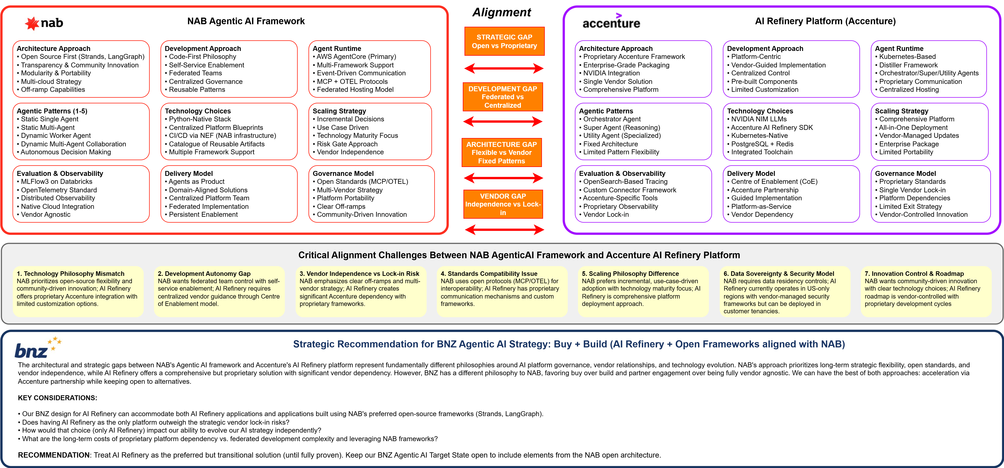
AI Refinery is misaligned with NAB Agentic AI strategy

Slide 6
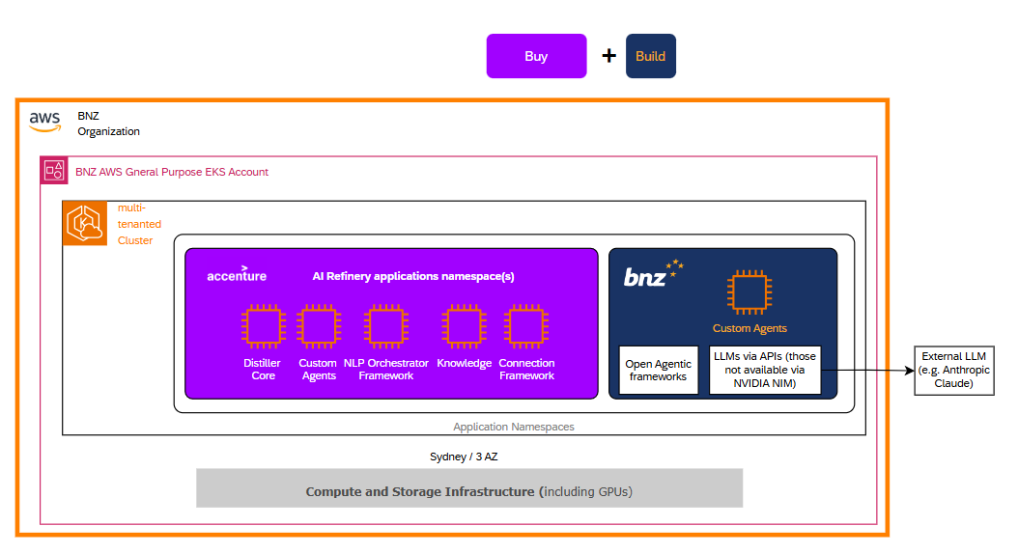
Our BNZ design for AI Refinery can accommodate both AI Refinery applications and other built applications
Accenture Aligned
NAB Aligned

Slide 7
Partnering Considerations
Accenture and alternatives

Slide 8
Partnership vs DIY Decisions
DIY Approach Challenges for BNZ:
Talent Acquisition: Limited pool of AI experts in New Zealand; competing with global tech companies for scarce talent.
Investment Scale: Achieving significant AI ambition within a shortish timeframe might require disproportionate capital allocation (could be 10-20% of BNZ annual technology budget vs. 1-2% for larger banks).
Development Timeframe: Potentially 3-5 years to build internal capability vs. 6-18 months with partnership.
Opportunity Cost: Diverts resources from core banking transformation initiatives.
Risk Profile: Higher failure probability without proven AI platform development experience (85% failure rate for internal AI projects without external expertise).
Consultancy Partnership Advantages for BNZ:
Accelerated Time-to-Value: Leverage pre-built platforms and frameworks (e.g. Accenture / AI Refinery).
Access to Global Expertise: Tap into consultancy global team (e.g. Accenture's 40,000+ AI professionals and banking domain knowledge). However, given BNZ’s relatively small size as a regional bank, we may not get the A team.
Risk Mitigation: Shared accountability and proven implementation methodologies leveraged from other client engagements.
Cost Efficiency: Operational expense model vs. large capital investment in uncertain outcomes.
Focus on Core Banking: Maintain resources for customer-facing innovation, modernisation and regulatory compliance.
Recommended Strategic Approach for BNZ
Phase 1: Partnership-Led Foundation (0-18 months)
Engage a consultancy (e.g. Accenture) with a proven platform (e.g. AI Refinery) to provide foundational platform capabilities.
Consider different consultancies for strategy (e.g. Boston Consulting Group) versus implementation (e.g. Accenture).
Focus on high-impact, low-risk use cases.
Build internal AI governance and risk management capabilities.
Develop strategic partnership management expertise.
Phase 2: Selective Internalization (18-36 months)
Evaluate specific capabilities for potential internalization based on business criticality.
Maintain partnership for complex, rapidly-evolving AI technologies.
Build internal product management and integration capabilities.
Develop vendor management strategies for AI ecosystem.
Phase 3: Hybrid Optimization (36+ months)
Balance internal capabilities with strategic partnerships.
Selective build decisions for banking-specific, competitive-advantage use cases.
Maintain partnerships for infrastructure, platforms, and emerging technologies.
Focus internal efforts on customer experience and banking domain expertise.

Slide 9
Accenture AI Capabilities and Strategic Investment
Accenture's AI Platform Approach: Accenture has positioned itself as a leader in enterprise AI transformation through substantial investments in talent, technology, and industry-specific solutions, making it particularly well-suited for banking partnerships.
Workforce and Investment Scale:
40,000+ Data / AI Professionals (as of June 2023) across Data & AI practice, with plans to double AI talent to 80,000 by 2026 through hiring, acquisitions and training.
$3 billion investment over three years (2023-2026) in AI capabilities and talent acquisition.
20,000+ GenAI-proficient staff in India operations alone as of February 2024.
Significant AI consultancy booking $2bn of AI-related projects in 2024 by July.
Banking Domain Expertise: Extensive financial services practice with regulatory compliance specialization.
Technology Stack and Platforms:
AI Refinery: Comprehensive platform for enterprise AI transformation with banking-specific modules.
Distiller Framework: Newly launched agentic AI framework designed for scalable industry solutions (2025).
Multi-vendor Integration: Unclear how framework-agnostic is Accenture’s approach and how multiple AI platforms and deployment models are supported.
NVIDIA Partnership: Leveraging NVIDIA AI Enterprise software for advanced capabilities including physical AI.
Financial Services Specialization:
Regulatory Compliance Integration: Built-in frameworks for banking regulations (Basel III, DORA, EU AI Act).
Risk Management: Specialized models for credit risk, operational risk, and model validation.
Customer Experience: Proven implementations in conversational AI, personalization, and fraud detection.
Data Sovereignty: Flexible deployment across public cloud, private cloud, on-premises, and sovereign infrastructure.
Deployment Flexibility:
Multi-Cloud Support: AWS, Azure, Google Cloud platform integrations.
On-Premises Options: Self-managed deployments for highly regulated environments.
Hybrid Models: Integration between cloud and on-premises components.
Regional Data Residency: Compliance with local data protection requirements.
Scale of Banking Engagements:
Global Banking Portfolio: Good client base across retail, commercial, and investment banking.
AI Transformation Programs: End-to-end implementations from strategy through operations.
RegTech Solutions: Specialized offerings for regulatory reporting and compliance automation.
Innovation Labs: Collaborative development environments for proof-of-concept and pilot programs.
Partnership Model Advantages:
Risk Sharing: Shared accountability for AI implementation success.
Accelerated Delivery: Pre-built frameworks reduce implementation timelines from years to months.
Global Best Practices: Access to cross-industry AI implementations and lessons learned.
Continuous Innovation: Ongoing platform evolution through R&D investment and client feedback.
Alignment with BNZ Requirements:
Scale Match: Mid-tier banks (like BNZ) represent optimal partnership targets - sufficient complexity to justify enterprise AI but manageable scope for focused implementation.
Regional Expertise: Strong presence in Asia-Pacific with understanding of local regulatory environments.
Partnership Philosophy: Emphasis on building client capabilities rather than creating dependency.
Technology Transfer: Commitment to developing internal client AI literacy alongside platform implementation.
Competitive Differentiation:
Banking Focus: Industry-specific solutions vs. generic enterprise AI platforms.
Full-Service Model: Strategy, implementation, and operations support vs. technology-only vendors.
Global Scale with Local Delivery: 40,000+ AI professionals with regional implementation teams.
Proven ROI: Track record of successful AI transformations in comparable banking institutions
Relationship: Already a BNZ partner.

Slide 10
References
Technology modernisation - Tech Spike - AgenticAI Feasibility Assessment. NAB, August 2025.
AI Refinery – Design. Accenture. August 2025.
AI Refinery – Design on a page. BNZ / Accenture, August 2025.

